Slide 1
University Ranking Model
INFO- 5100 Application Engineering and Development Assignment-3
Created By- Jinal Mamaniya Tarun Balwani
Sneha Methwani

Slide 2
Problem Statement
Building a software engineering design to measure the quality of education that universities deliver to their students by ascertaining the professional growth of graduates over a period of years.
Building a software engineering design to measure the quality of education that universities deliver to their students by ascertaining the professional growth of graduates over a period of years.
Notes:
Building a software engineering design to measure the quality of education that universities deliver to their students by ascertaining the professional growth of graduates over a period of years.

Slide 3
How best selection of courses, classes will result into getting a good job?

Slide 4
The Proposed Solution

Slide 5
Criteria for Ranking and Feedback
Most popular courses
Ranking/Feedback by students in feedback module
Total occupancy of each department
Total number of enrollments for the courses includuding waiting list
Total number of students secured co-op/part-time/full-time
The factors which affect the rating of the course is given by the current students who secure part-time/co-op and also alumina have been emphasized upon directly to the ranking of the university

Slide 6
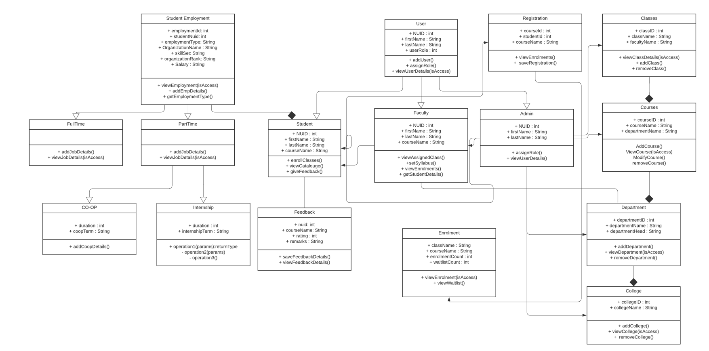
Class Diagram

Slide 7
Design Model
In order to create a performance measurement solution which analyses how faculty and courses contribute towards a students professional growth, it is imperative that first, the Admin/department should be able to analyze which all courses helped the student in that and through that learn about what all changes and modifications are required in the curriculum. In addition to have more attention to the Student feedback module which is given by current and former students in the course module area.

Slide 8
Implementation

Slide 9
Data Generation
We have manually created the data.The data is generated for a period of 6 years
Below are the departments- Information Systems Software Enginerring DAMG
Each department has few courses that are randomly assigned
Each year has 3 semesters- Spring, Summer and Fall
Number of Students enrolled for each course is equal to the seats assigned for each course

Slide 10
The various dashboards show the courses and the departments ranking

Slide 11
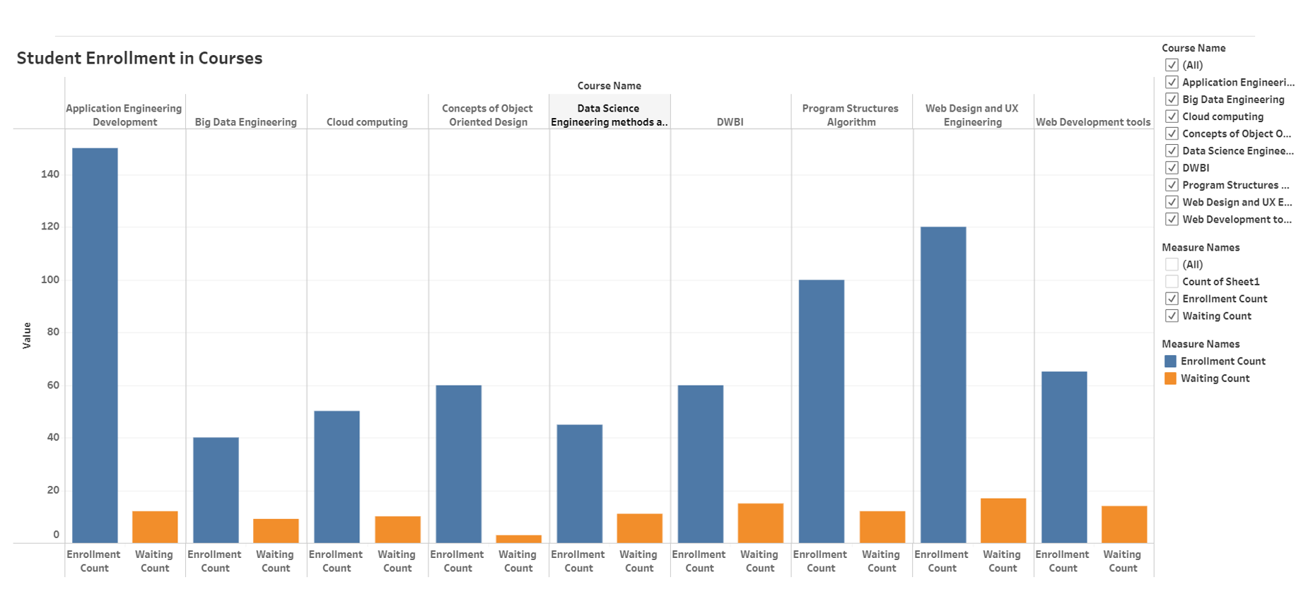

Slide 12
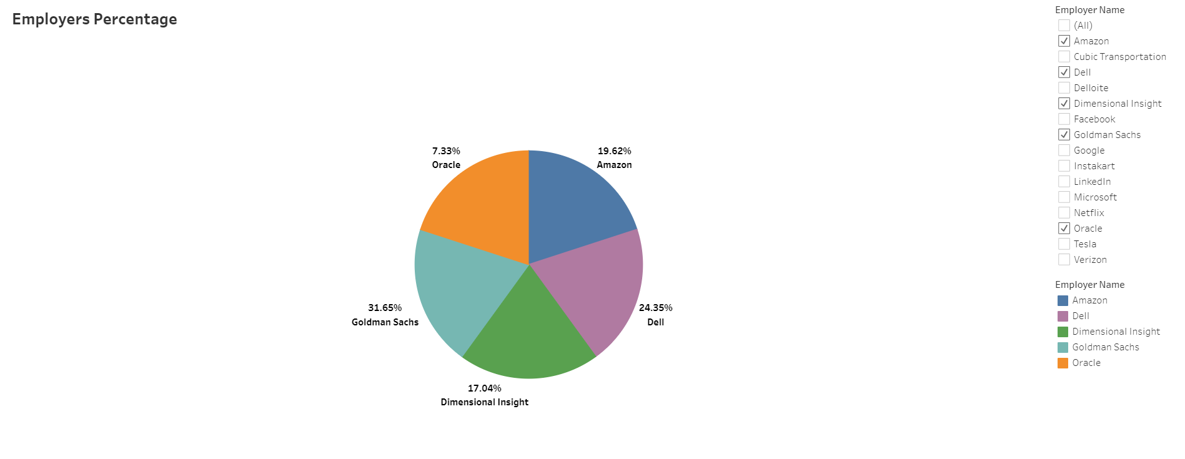

Slide 13
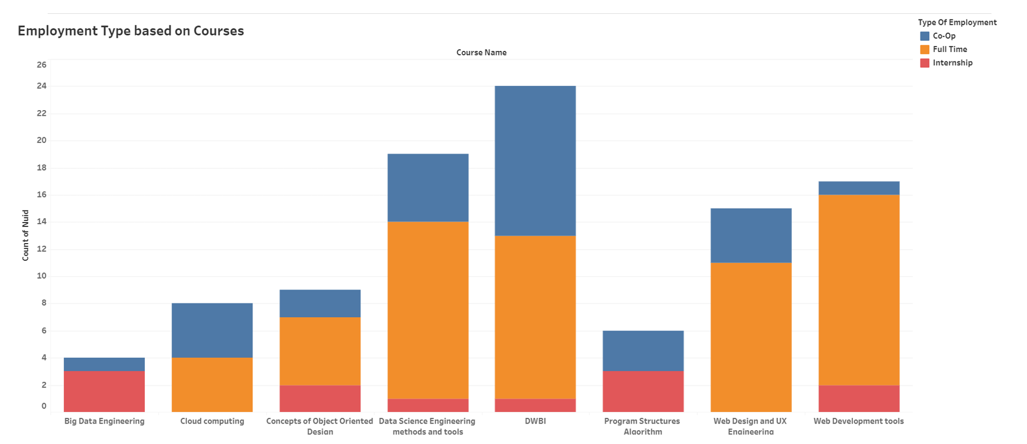

Slide 14
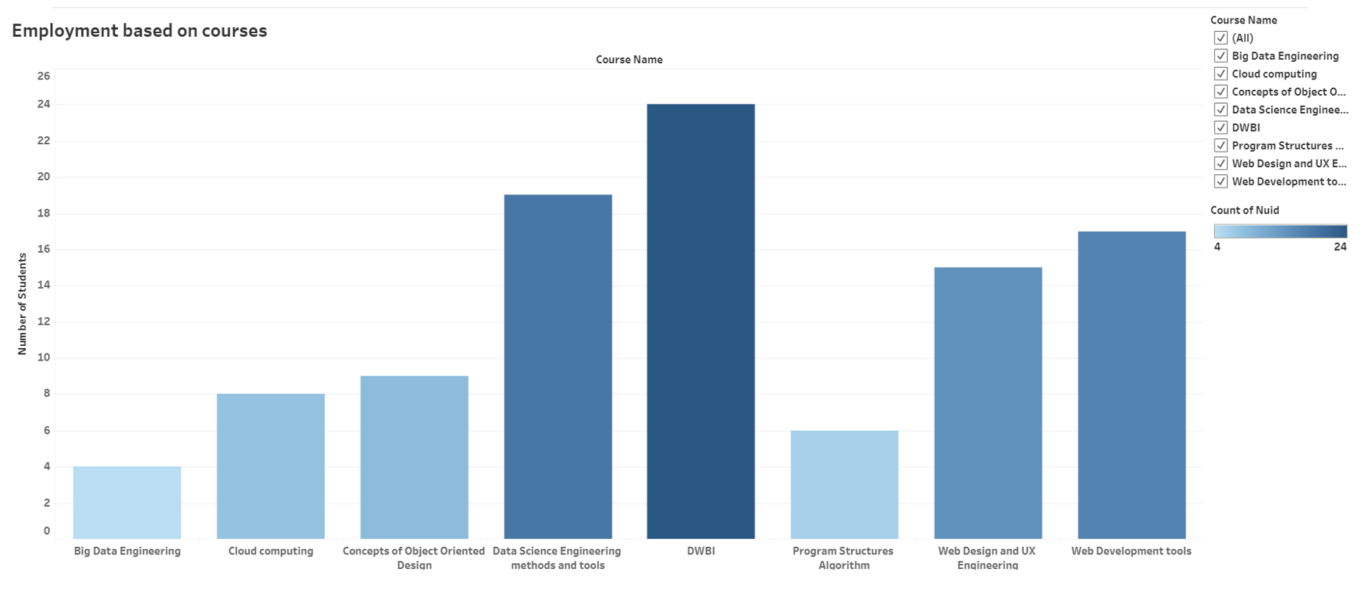

Slide 15
Conclusion
With the help of given dashboards, we can rank the following
Course offered amongst all the departments
Total number of seats occupied by every department
Most popular course by the department
Total Registration of the course
Total waiting of the course

Slide 16
Solution for Educational System

Slide 17
The Feedback forms used in this education system model which helps the university model to capture and view the current students and former students given feedback with respect to their course which helped them to acquire the full-time/part-time/co-op job opportunity.
The same way education system can get information from their alumni students whether the university they have landed for their bachelors was because of the certifications they did other than school studies or just the school syllabus helped them to reach there.
At the end of the educational year in educational system students will be rating the courses they were taught an according the ratings the faculty can make changes in their curriculum for the upcoming batches.

Slide 18
Implementation of educational systems
After the courses are ranked, the one ranked in the lasts can be worked up by the colleges for better output of the courses.
So, when admin click view option then he/she can view list pf colleges, course, number of enrollments, waiting list for the class, student feedback and ranking form, Student and faculty details.
The Feedback forms used in this education system model which helps the university model to capture and view the current students and former students given feedback with respect to their course which helped them to acquire the full-time/part-time/co-op job opportunity.

Slide 19
Thank You

